Slide 1
Ethics | Experiments
Doing Political Research, Week 9

Slide 2
Assessment
Marks and feedback for critical review essay to be released next Monday
Second Quiz to be released on Friday (deadline: Friday 15th December)
Research Design: deadline on 8th January, full details on Moodle

Slide 3
Next Week: Research Design Workshop
Bring along your ideas for the research design
No formal presentation required, but be prepared to speak for a few minutes about your ideas
Chance to get feedback at whatever stage you are

Slide 4
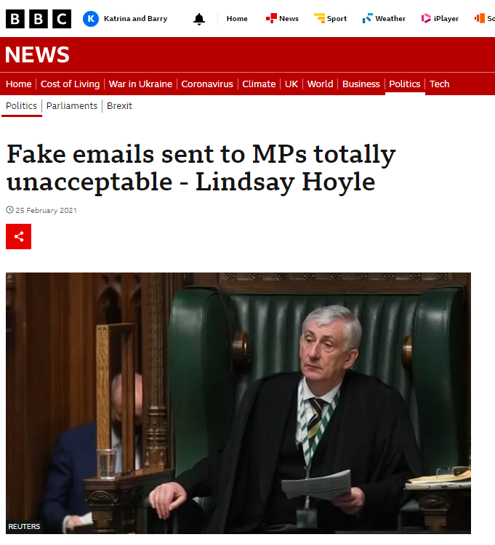
The Audit Experiment Scandal (Campbell and Bolet)
Was this research ethical? Should this research project have been conducted? Why, or why not?
Why did the project run into trouble?
How could the project have been improved to have not caused such a scandal?

Slide 5
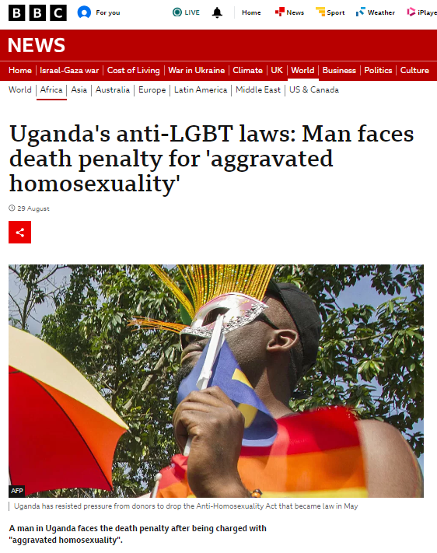
Research Ethics
You are researching LGBT activism in Uganda against the death penalty for homosexuality
You are considering these methods: interviews with LGBT activists, focus groups with LGBT people, an ethnography of protest events against the law
What ethical issues do you need to consider?
Would you be able to use all the methods? What specific ethical challenges might you face?

Slide 6
Designing a Political Research Experiment
Choose a research question to investigate a political process or phenomenon and design an experimental study to answer it.
What kind of experiment will you use: lab, field, survey or natural? What will be the treatment(s) and control conditions?
How will you ensure randomisation of your treatment or intervention?
What population will you seek to generalise your findings to?

Slide 7
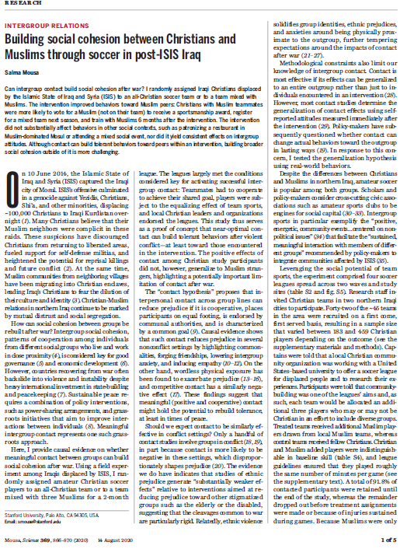
Mousa
What kind of experiment did Mousa conduct?
Was the intervention suitable for testing the theory? How realistic was the setting and the intervention?
How generalisable are the findings? To what population could the findings be generalised?
How could the study have been improved? What other methods could have been used?

